Slide 1
Predicting Income Level
Using the UCI dataset called “Adult DATA SET”

Slide 2
Abstract
Predict whether income exceeds $50K/yr based on census data. Also known as "Census Income" dataset.

Slide 3
Potential Uses
Allow a user to project their life/career and figure out their likelihood of reaching 50k

Slide 4
Features
Age
Work Class
Education
Marital Status
Occupation
Relationship
Race
Sex
Capital Gain
Capital Loss
Hours Per Week
Native Country

Slide 5
Target
Predict if a person’s income exceeds $50K/yr

Slide 6
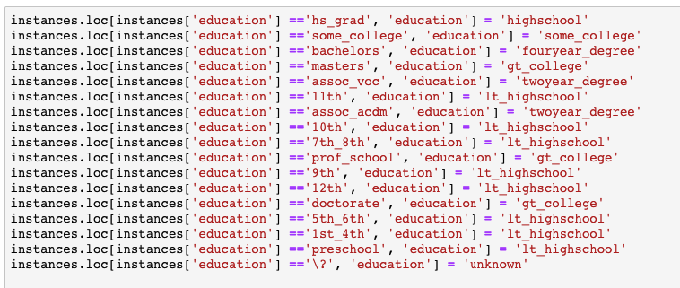
Ingestion & Wrangling
Very simple CSV Ingestion
We needed to combine some values to make better categories
One hot many other fields

Slide 7
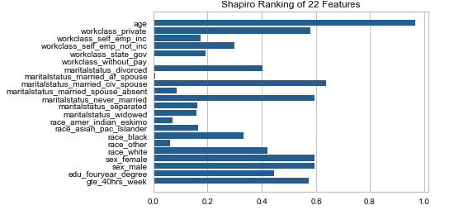
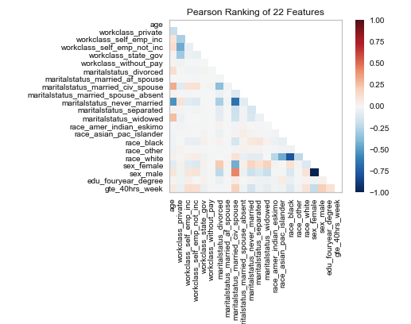
Analysis and Modelling
We plan on using Yellowbrick for Model analysis

Slide 8
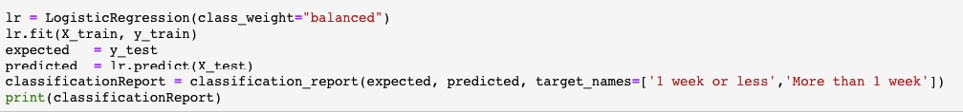
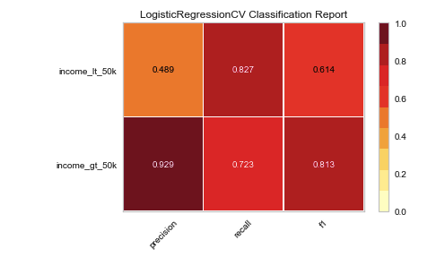
Logistic Regression
We had to balance the class weight because of the training data.

Slide 9
Visualization
To be determined…

